Slide 1
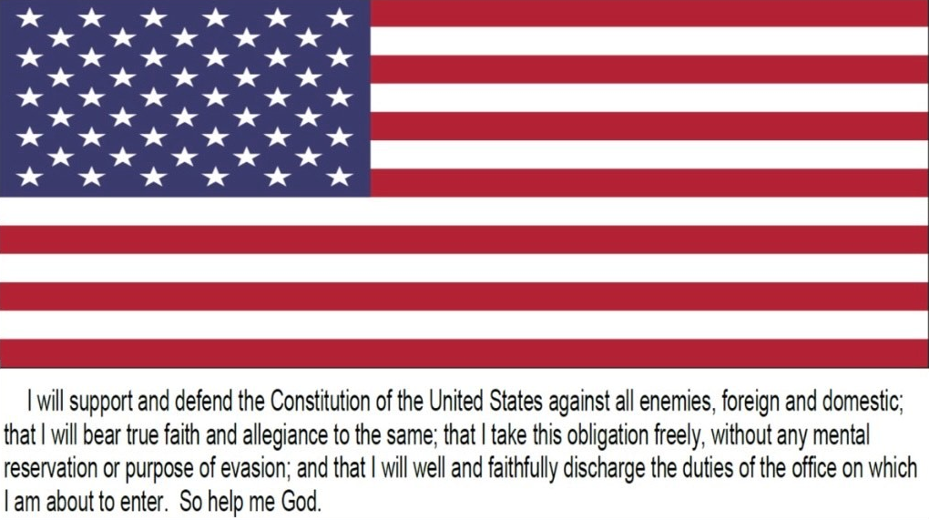

Slide 2
***Oath of Office Employees Only*** (Please log into the USA Staffing Account link below): https://onboard.usastaffing.gov
Once logged in, please ensure that you’ve completed the documents listed below:
SF61 Form
SF181 Form
SF256 Form
2nd Signature on the OF306 Form (ensure that you complete the second signature on line 17b of the OF306 as dating it will digitally sign and date it).

